Slide 1
Pima Community College
ASCEND
State Symposium April 22, 2023

Slide 2
Abstract
The upper atmosphere is an inhospitable environment. The altitude in the upper atmosphere can reach up to 100 km, and the pressure can be as low as 10^-11 atm and temperature as low as -100°C, making it extremely difficult for any living organism to survive. This study looks at a very tiny crustacean of the order Anostraca indicating their ability to adapt to these harsh conditions.The question that arises is how do crustaceans survive in such conditions? This multiple semester experiment has studied the viability of both young, adult, and cyst forms of this crustacean in the extreme conditions of the upper atmosphere. Their survival in the upper atmosphere also provides valuable insight into the possibility of life on other planets, which was once considered impossible. Research on crustaceans is ongoing, and it is hoped that further results will shed more light on the possibility of life in hostile environments.

Slide 3
Objectives
Record data for small crustaceans of the order Anostraca as Adult and Infant stages of development for their viability after being exposed to extreme conditions. Compare this with data collected as cysts.
Determine the effect of the harsh environmental conditions by measuring pH and dissolved oxygen levels.
Record internal video of the events of the crustaceans.
Determine whether Artemia can survive in extreme, other worldly conditions as cysts, infants, and adults.

Slide 4
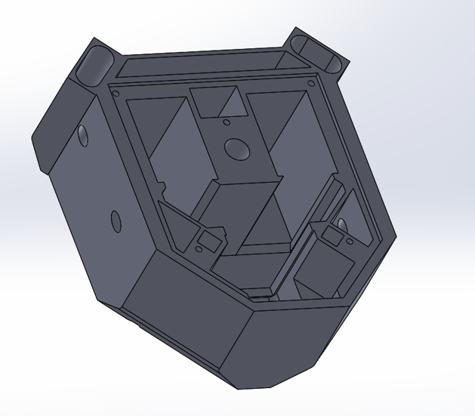
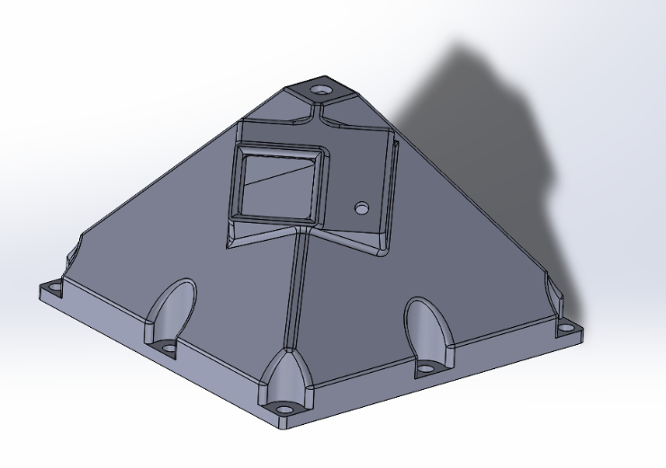
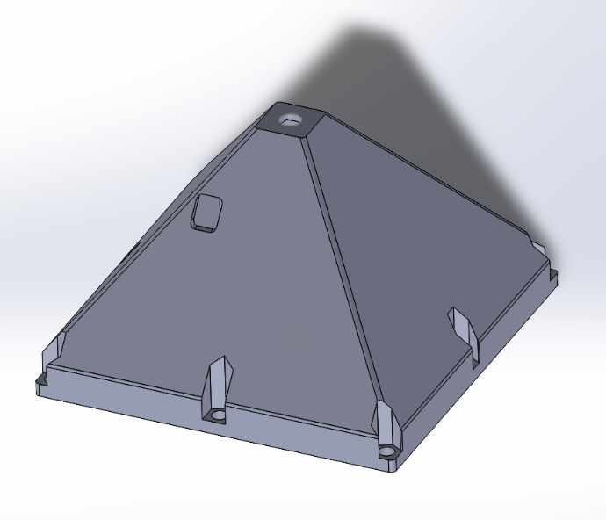
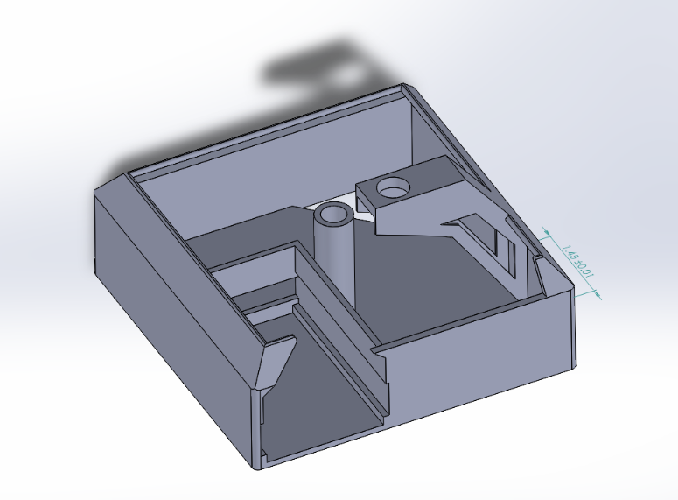
Payload Design
The payload design is a pyramid with different components to make the assembly easier on the day of the launch. There are two major components inside the payload. One is the tray where the arduino, sensors, battery, power switch. In addition wiring leads from this tray to different tray where the biological experiment is located. This experimental tray holds the cuvettes with the Adult and Infant crustaceans, bright white LEDs and a camera to view the inside of this portion of the payload. Everything was designed and measured to the specifications of what is need to keep everything safe and secure during its voyage up and down.
Top section. Contains camera
Experiment Tray
Bottom section.
Electronics tray

Slide 5
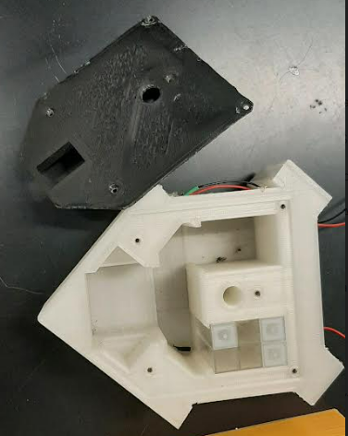

Experiment Tray Design
The cuvette holder is 3D printed out of translucent PLA and is secured to the shelf of the payload using zip ties. The holder is constructed to hold 12 cuvettes and a GoPro Hero session so we will have footage of the internal events during flight. Parts of the walls have been hollowed out to let a light strip fit to have visibility for the camera.

Slide 6
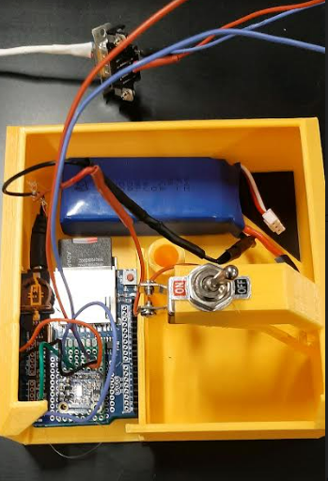
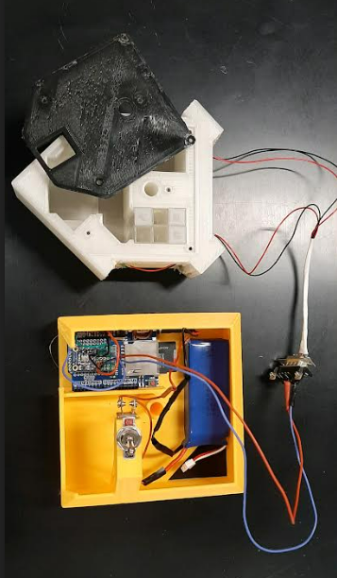
Payload Electronics
MPL3115A2 Sensor Records Temperature, Altitude, and Barometric
Pressure
Arduino UNO Data Logger
GoPro Hero Session
GoPro Hero 07 (bluetooth enabled/video feed to phone)

Slide 7
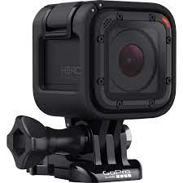
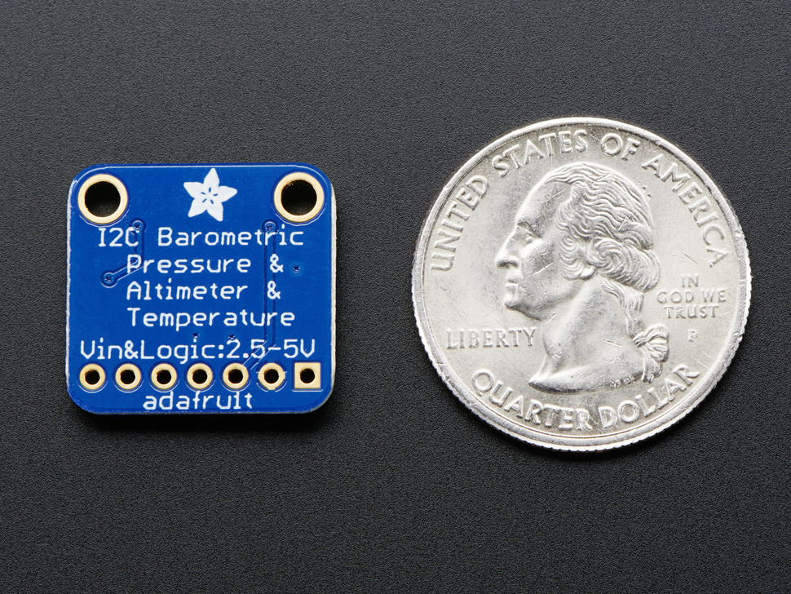
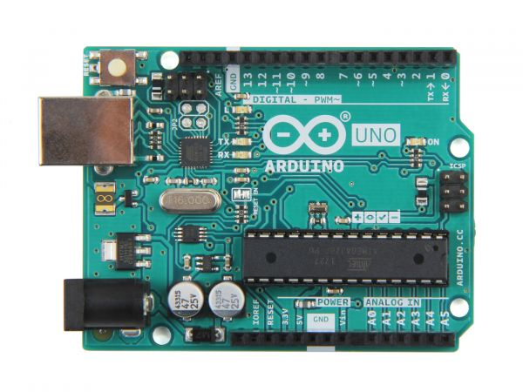
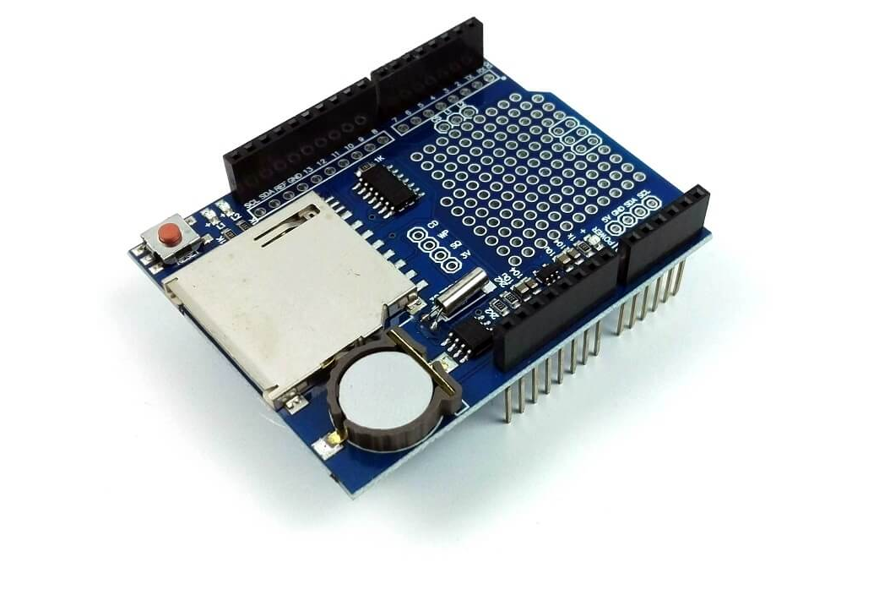
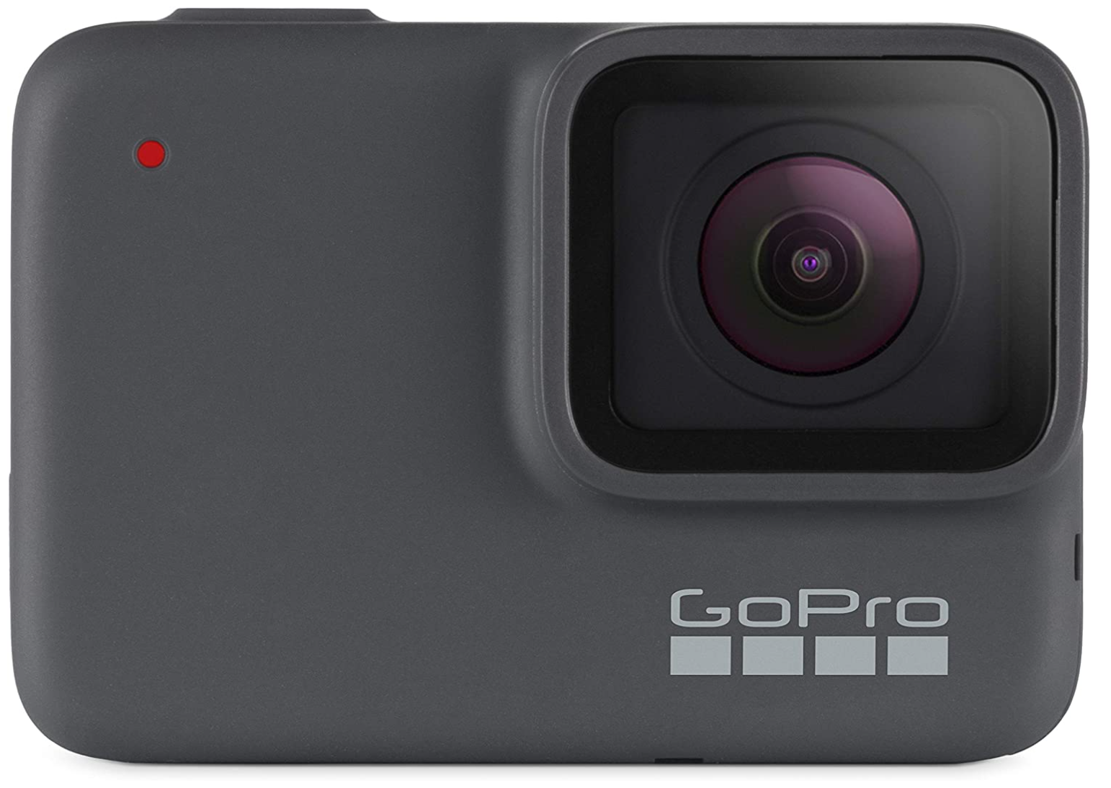
Electronics
MPL3115A2 Sensor.
Arduino Uno
GoPro Hero Session
Data logger shield for the Arduino Uno
GoPro Hero 07

Slide 8
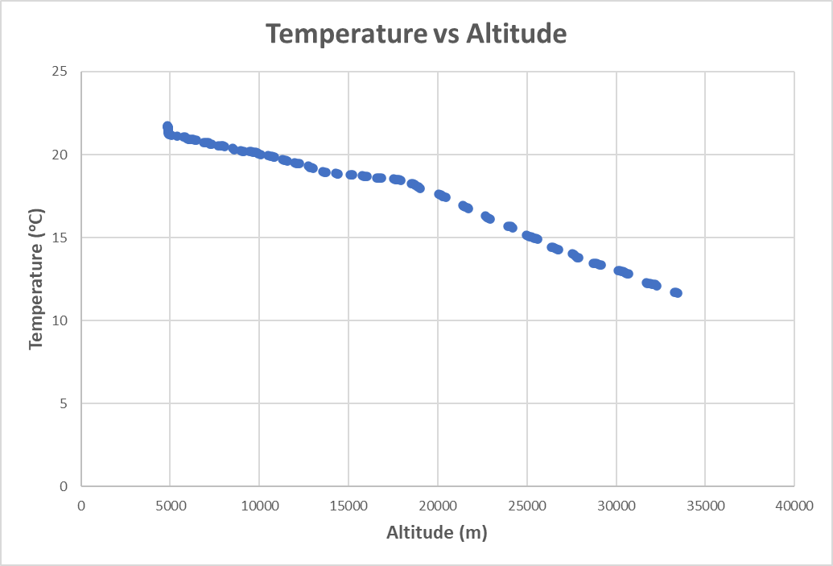
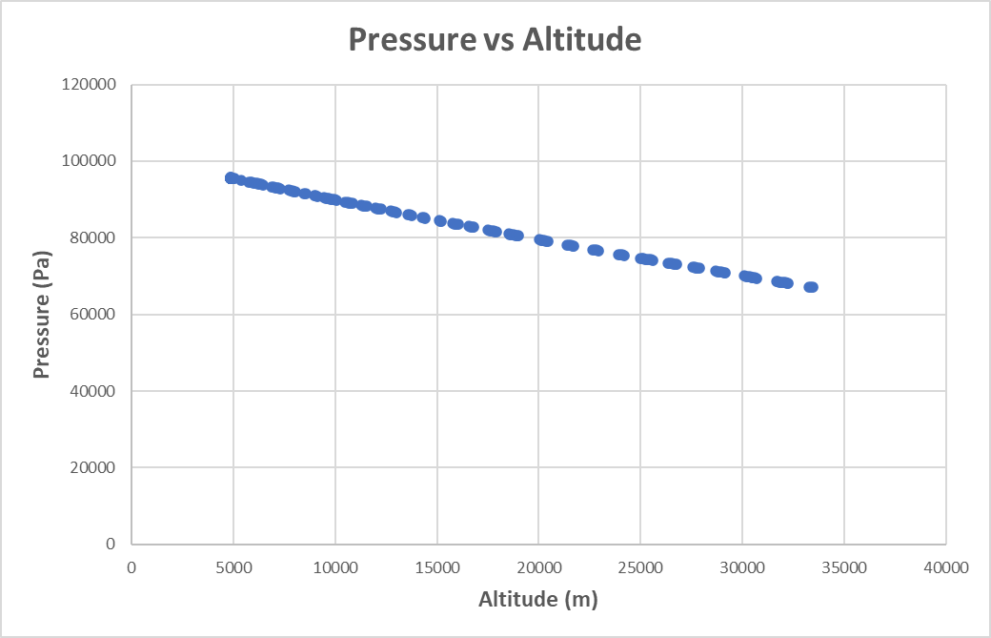
Data (note >1000 data points were recorded)

Slide 9
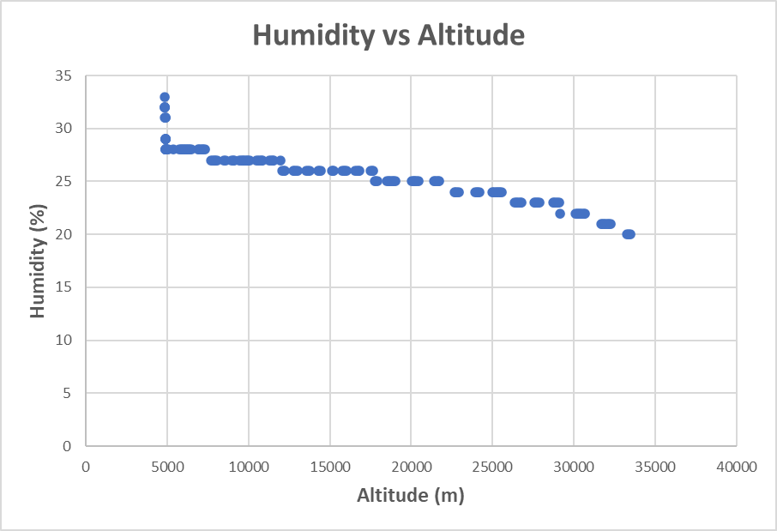
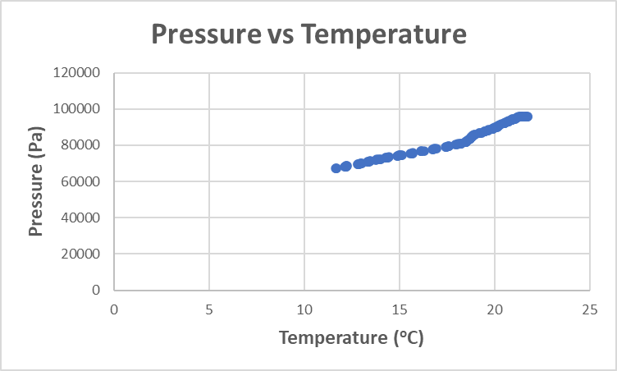
Data (cont) (note >1000 data points were recorded)

Slide 10
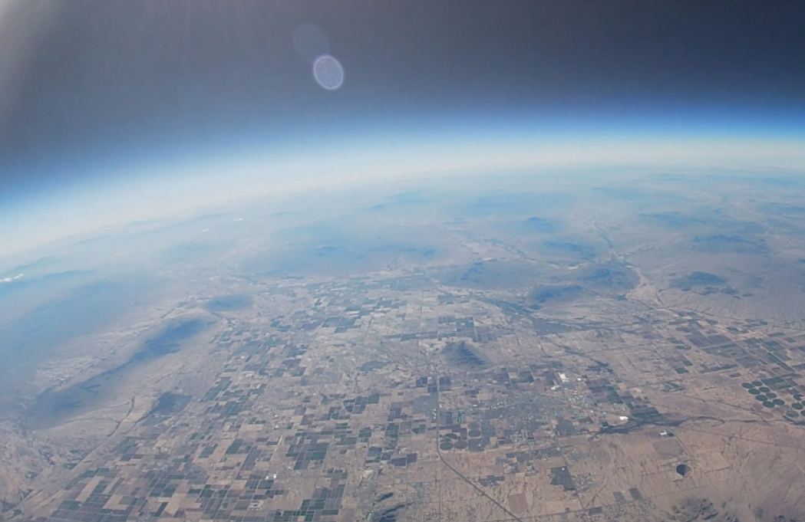
Snapshot of exterior video footage

Slide 11
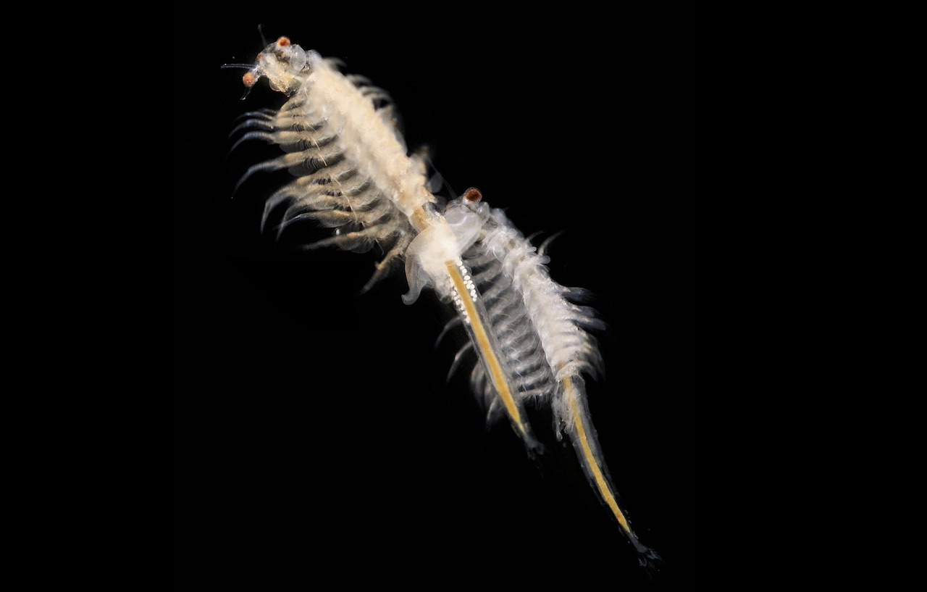
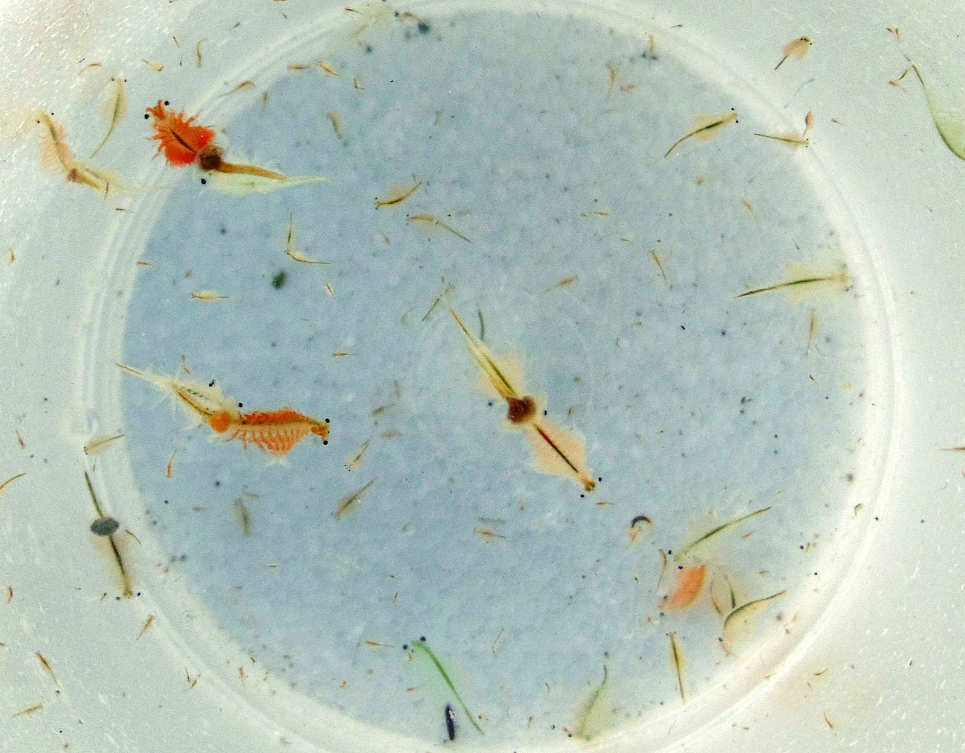
Artemia Franciscana
Small crustaceans of the order Anostraca (class Branchiopoda; Family Artemiidae Grochowski; Genus: Artemia Leach) with a maximum length of about 0.4 inch (1 cm), they are the largest animals that live in the Great Salt Lake. They are an important part of the ecosystem even though their size is very small. This study will investigate both Adults and Infants respiration rates by looking at the dissolved oxygen content and pH of their environment and comparing this to control groups.

Slide 12
Initial Prep - Crustaceans
Testing Results: Each camera battery has an operating time of 3 hours.
The crustaceans were bought as a kit and prepared 5 days before launch so that they would be mature enough to be moved and big enough to observe but are still considered Infants.
Adult crustaceans (>10 days old and with two or three eyes) will be used as the Adult specimens.

Slide 13
Data
 | DO (%) Before Flight | DO (%) After Flight | mV Before Flight | mV After Flight | DO (%) 48 hours post flight | mV 48 hours post flight
Adults | 98 | 97 | 567 | 487 | 92 | 384
Control | 98 | 92 | 567 | 338 | 89 | 388

Slide 14
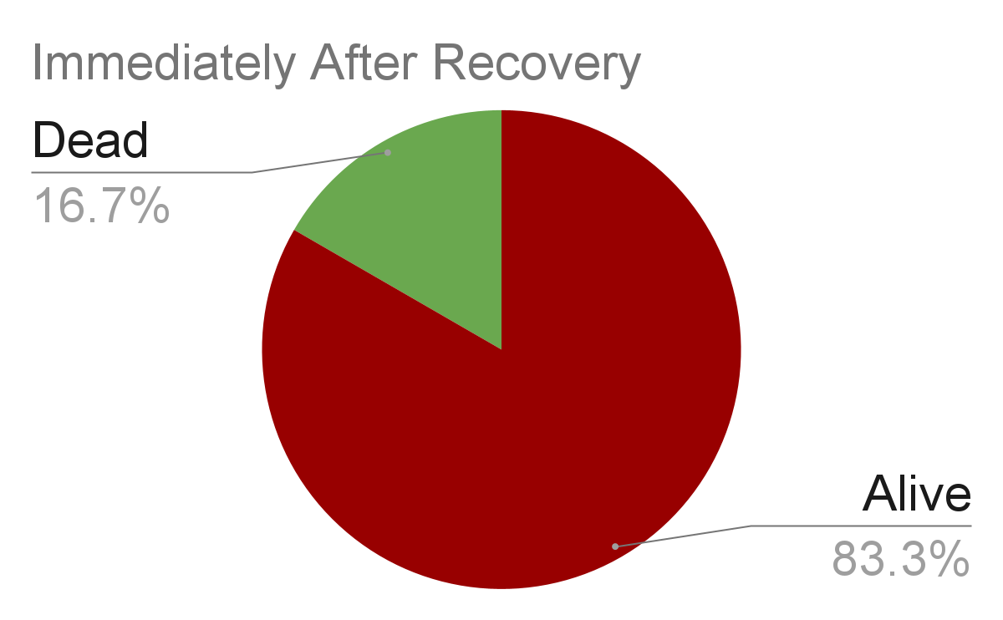
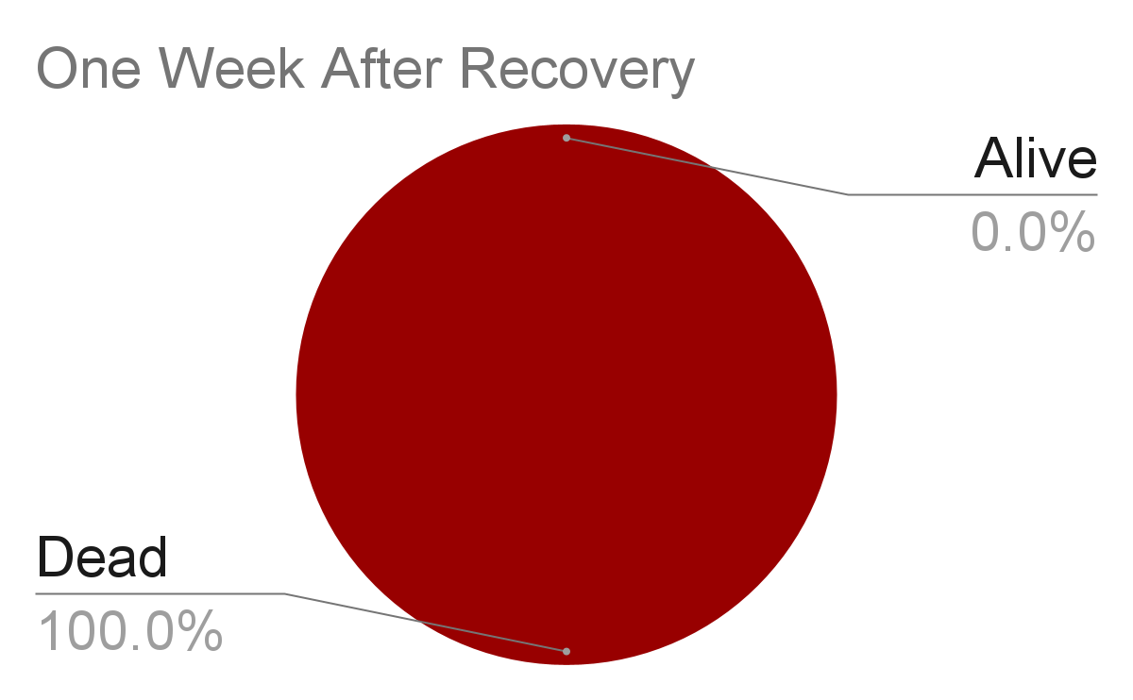
Data (cont.)

Slide 15
Discussion
The payload reached an altitude of slight excess of 100,000 feet for the Fall launch and for the Spring launch. In addition, the temperature, pressure, humidity, and altitude was successfully measured and recorded.
In the Fall semester, cysts and infants were sent into the upper atmosphere where video footage captured the “boiling” of the water within the cuvettes due to the large drop in atmospheric pressure starting at approximately 50,000 feet.
In the Spring semester, the Adults and Infants were studied and it was found that the DO and pH data that was recorded showed a significant difference between the control group and the specimens that were in flight to the upper atmosphere.

Slide 16
Conclusions
What does all this data indicate about the viability of sustaining life on other planets that do not have conditions similar to the Earth?
Under different conditions and at different locations in the solar system, we will need different types of technology to maintain our survival as humans. Planets have different pressure, temperature, and humidity levels. Although crustaceans have tough bodies, many could not survive the journey up into our atmosphere due to the extreme conditions on our planet, and those who did weren't able to survive the aftereffects. We should use this information if we ever want to visit another plant because the higher we go up the colder it gets, so we need to make sure we are well insulated to keep our body temperatures up. All other variables, including crustaceans' respiration, decreased significantly as altitude increases which shows a significant temperature drop and change of pressure. Their infant form seems to be far more durable but further research is needed.

Slide 17
Acknowledgements:
Arizona Space Grant Consortium Arizona Near Space Research NASA
Mentors:
AnnMarie Condes Ross Waldrip

